Slide 1

Department Of Computer Science

Slide 2
Project Title Speech2Face
Shahzaneer Ahmed
CIIT/SP21-BCS-087/ISB
Shayan Zameer
CIIT/SP21-BCS-088/ISB
Supervisor:
Mr. Tehseen Riaz Abbasi
Department Of Computer Science
Submission Date:
(6th November 2022)

Slide 3
Project Category
Project Categories are
B- Web Application/Web Application based Information System
C- Problem Solving and Artificial Intelligence
E- Smartphone Application
H-Image Processing

Slide 4
Abstract
Speech2face is a project that is mainly built to recognize the face general structure and gender with audio waves.
The user can also enhance the images with image optimization and features enhancer of the system.
Currently no Software is available which contains all these features in a single system.
It is nearly impossible to predict the appearance of same person with his/her voice. But artificial Intelligence has made it.
It will automate the attendance system and reinvigorate the authentication system.
It will prove an asset to the security and agencies by recognizing criminals.
It can also be used as a general-purpose software for recognizing the individuals in old audios and images.

Slide 5
Introduction
Recognizing the facial features of person based on their audio notes by a human being who don’t actually know the person make no sense in real life.
There is no way to do so But Artificial Intelligence has made it possible to do so.
The Machine learning and deep learning can be trained on data of all type of people with some mathematical perspectives of voice that uses clustering algorithms and categorize the people in different domains.
The image will not be 100% real but it gives a lot of insights of data which can help us to identify the person.

Slide 6
Problem Statement
There are many loop holes in the user authentication used in security systems including banks, critical profile accounts and many more places where authenticity of user should be the first priority.
Every other person who has the credentials of the account of that specific user can log into the account specified merely for the former.
In case of criminals Scenes, It is observed that the faces are not recognized hence the criminals are not captured by the security forces.
Mostly the voice can be seen but the faces are under veil thus cannot be seen directly.

Slide 7
Problem Solution
Many Application users and Agencies have requested system that are helpful, efficient and reliable in user authentication.
Speech2face will provide an acceptable solution to these concerns.
Security agencies face many problem sometimes because image of criminals are not revealed by the camera. Speech2face will help in this regard.
The old audio and video notes can be used to find the insights about the person’s basic information.

Slide 8
Vision Statement
For users who want to authenticate their systems and find a visual representations of voices depending upon different factors .
Speech2face is an application that will help in authenticating users and finding real time insights about voices unlike the data analyzed model which are not in practical usage form.
The user will user our application and will be able to transform the audios into images and gain generic information about the person whose voice is under observation.

Slide 9
Related System Analysis/Literature Review
The related system analysis and literature review of other applications related to our project are given below:
Application Name | Weakness | Proposed Project Solution
Sound Classification | There are too many sounds so there is a possibility that system can’t get sound and displays result according to need | The application deals with sound and converts int facial images. The risk is low as compared to related project.
Face net | There are number of areas that are still left to be explored and how different ages and race play a role in face recognition.
Speech2face | No Mobile application, only available as a website | The application will be available on web as well as mobile application.

Slide 10
Advantages/Benefits of Proposed System
Following are the advantages of our application:
Privacy of person is there because the resemblance is apparently not 100% right.
The application helps investigation teams to get an idea how the criminals look like by using their voice.
We evaluate and numerically quantify how and in what matter reconstruction from audio resemblance the true face of speaker.

Slide 11
Scope
Speech2Face will be a Research and development-based Product with the main functionality to convert the voice into vector form and the vector form to image form and thus assisting in providing insights about the details of the person whose voice is under observation. It will be developed using different technologies and Deep Learning and machine learning techniques will be used. The Image generated can be modified in accordance with the users’ perspective
General user: They can retrieve their images from their voice notes.
Security Agencies: It Can help them identify the criminals and speed up the process of resolving complex cases.

Slide 12
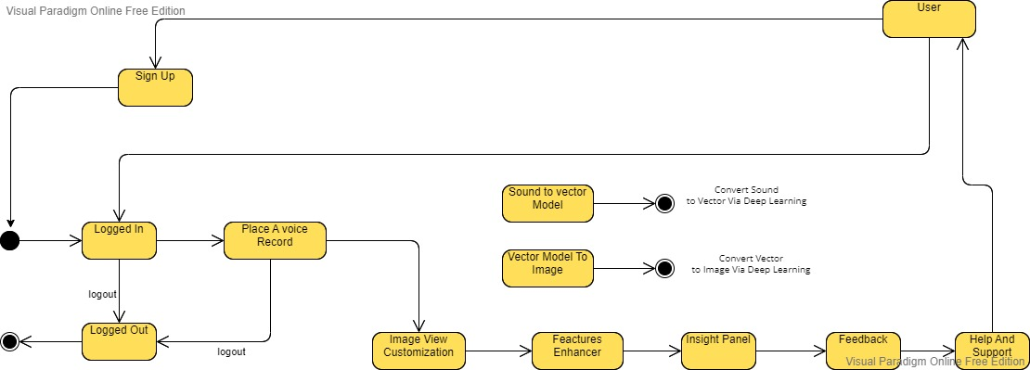
Scope
Context Diagram for Speech2face

Slide 13
Modules
The modules of the project are listed below:
Module 1: Profile Management
Module 2: Place Voice Record
Module 3: Sound to Face Vector Model
Module 4: Face-Vector to Face-Image Model
Module 5: Image View Customization
Module 6: Features Enhancer.
Module 7: Insight Panel
Module 8: Feedback panel
Module 9: Help and Support

Slide 14
Module-1: Profile Management
The main functions of this modules are:
MF-1 Sign Up
MF-2 Log In
MF-3 Sign in as Guest
MF-4 Sign Via Phone
MF-5 Sign Via Voice
MF-6 Update profile Information
MF-7 Delete Profile
MF-8 Logout

Slide 15
Module-2: Place Voice Record
The main functions of this modules are:
MF-1 Record voice
MF-2 Upload existing voice
MF-3 Upload existing video to fetch voice
MF-4 Update video
MF-5 Update voice
MF-6 Delete Voice
MF-7 Delete video

Slide 16
Module-3: Sound to Face Vector Model
The main functions of this modules are:
MF-1 Sound to vector modeling via Deep Learning
MF-2 Generate vector Model

Slide 17
Module-4:Face-Vector to face-Image Model
The main functions of this modules are:
MF-1 Vector to image model via deep learning.
MF-2 Generate image model.

Slide 18
Module-5:Image View Customization
The main functions of this modules are:
MF-1 Brightness Control
MF-2 Saturation Management
MF-3 Skin Color Management
MF-4 Filters

Slide 19
Module-6: Features Enhancer
The main functions of this modules are:
MF-1 Face Shape Enhancement
MF-2 Nose Enhancement
MF-3 Eyebrow Enhancement
MF-4 Beard Maker
MF-5 Eye Enhancement

Slide 20
Module-7: Insight Panel
The main functions of this modules are:
MF-1 View Report
MF-2 Download Report
MF-3 Share on Socials

Slide 21
Module-8: Feedback Panel
The main functions of this modules are:
MF-1 Rate Result.
MF-2 Feedback in terms of words
MF-3 System lagging checks

Slide 22
Module-9: Help and Support
The main functions of this modules are:
MF-1 Chat With Bot
MF-2 Contact Support Team
MF-3 Change Bot’s Language
MF-4 View Bot Query History

Slide 23
System Limitations/Constraints
Following are the limitations of our proposed system:
The System cannot predict the image 100% correct.
The System is unable to guess some voices if it consists of type on which the data is not trained.
The System can be accessed over the internet.

Slide 24
Software Process Methodology
Process Methodology
The software process methodology that we will use is Iterative Process Model.
Our application has finite number of functionalities and most of the requirements are surely not known.
The project is not very common and is research and development based.
Therefore, the most suitable process model we could select is iterative process model
Design Methodology
The design methodology we will be using is Object Oriented Approach because it increases the reusability of the code, and it would be easier for the team members to work together without any confusion.
Therefore, we are using Dart for Flutter, HTML, CSS languages which follows object-oriented approach.
Also, it is easier to describe the code using UML diagrams. So, OOP is the best approach which fits our framework.

Slide 25
Tools and Technologies
The tools and technologies that will be used in the project are provided in the table below
Tools And Technologies | Tools | Version | Rationale
 | MS Visual Studio Code | 2022 | IDE
 | Git | 2020.3.4 | IDE
 | MS Word | 2021 | Documentation
 | MS Power Point | 2021 | Deployment
 | Netlify | 2022 | Mockups Creation
 | Flutter | 3.3 | SDK
 | Figma | 2022 | Mockups Creation
 | MS Visual Studio Code | 2022 | IDE
 | Technology | Version | Rationale
 | Dart | 3.55 | Client -side Scripting
 | Firebase | 5 | Ready Made Backend
 | Html | 5 | Web Structuring
 | CSS | 3.0 | Web Design
 | JavaScript | ECMA Script 2017 | Event Based Programming language
 | Python | 3.8 | ML/DL programming language

Slide 26
Project Stakeholders and Roles
The Stakeholders of the project are:
Project Sponsor | RaviCom Solution Private Limited
Stakeholder | Shahzaneer Ahmed. Shayan Zameer Project Supervisor Name: Mr. Tehseen Riaz Abbasi.

Slide 27
Team Members Individual Tasks/Work Division
The Task Distribution is as follows:
Student Name | Student Registration Number | Responsibility/ Modules
Shahzaneer Ahmed | SP21-BCS-087 | (Module1-Module3-Module6-Module7) Mobile App, Documentation, Backend, ML,DL
Shayan Zameer | SP21-BCS-088 | Idrees Ghazi (Module2-Module4-Module5-Module8) Web A, Documentation, Artificial Intelligence, Design

Slide 28
Data Gathering Approach
The data gathering approaches adopted for the proposed system include surveys and interviews of general users, intelligence agencies and security forces.
The Data set which was trained to obtained from open source Kaggle platform which consist of voice implementation insight of different peoples of world with their corresponding facial features.

Slide 29
Concepts
The concepts that we would be learning are:
Concept-1: UI/UX Designing Via Figma
Firstly, we will develop the UI of the system using Figma.
Concept-2: HTML,CSS and, JS for Web development:
For web end, we are going to use HTML for web Structuring, CSS for design and Java Script for coding.
Concept-3: Flutter for Mobile App Development
For Mobile –end we are using flutter SDK. We will be learning to change the UI in Flutter Code using dart.
Concept-4: Fire Base For User Authentication And Data Storage
In this project, we will also implement backend using firebase for authentication and data storage using firestore database and firebase Auth package.

Slide 30
Concepts
Concept-5: Data Analysis using Numpy, Pandas and Matplotlib
For initial data analysis of data set we will use the power of python packages for statistical computations and visualization of data.
Concept-2: Machine Learning and Deep Learning using Tensor Flow and Keras:
The data set will be trained by machine learning techniques using python libraries for data modeling.

Slide 31
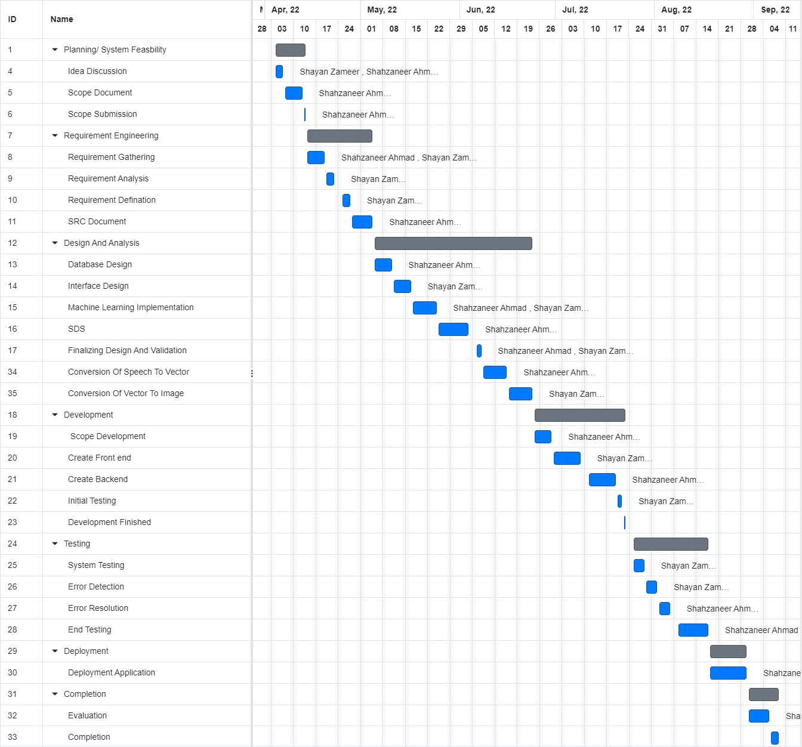
Gantt Chart
The Gantt Chart of the project is provided below:

Slide 32
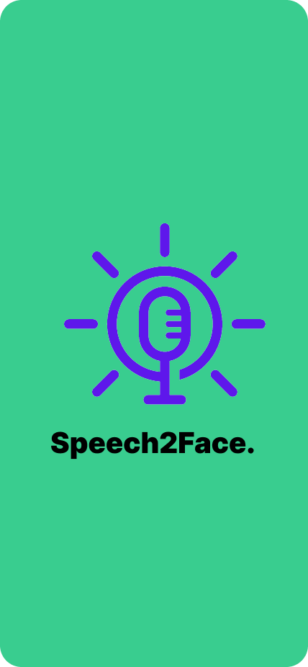
Mockups
Mobile Application Mockups are:
Figure 1: Splash Screen Mockup

Slide 33
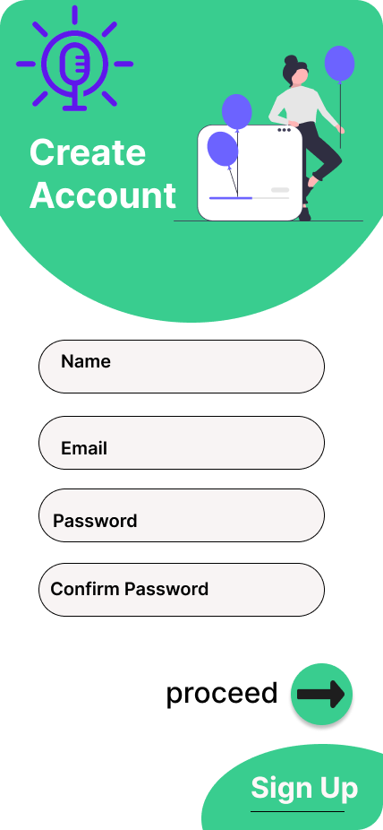
Mockups
Mobile Application Mockups are:
Figure 2: Sign Up Screen Mockup

Slide 34
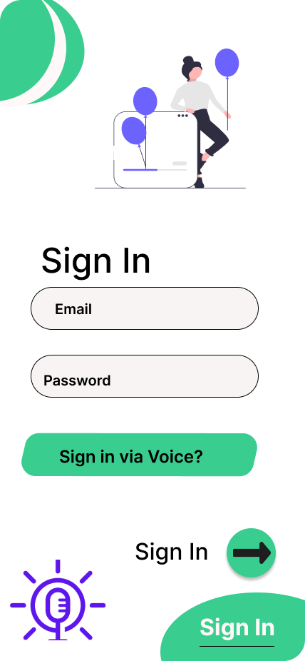
Mockups
Mobile Application Mockups are:
Figure 3: Sign in Mockup

Slide 35
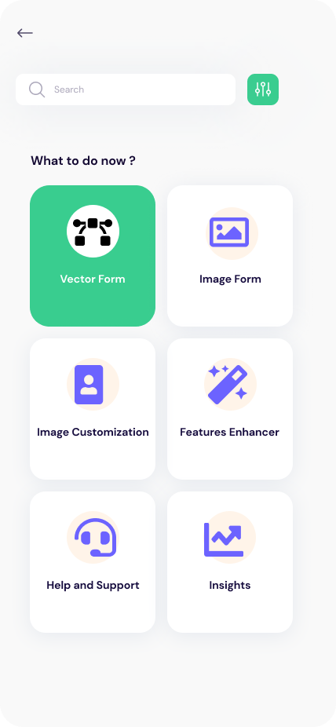
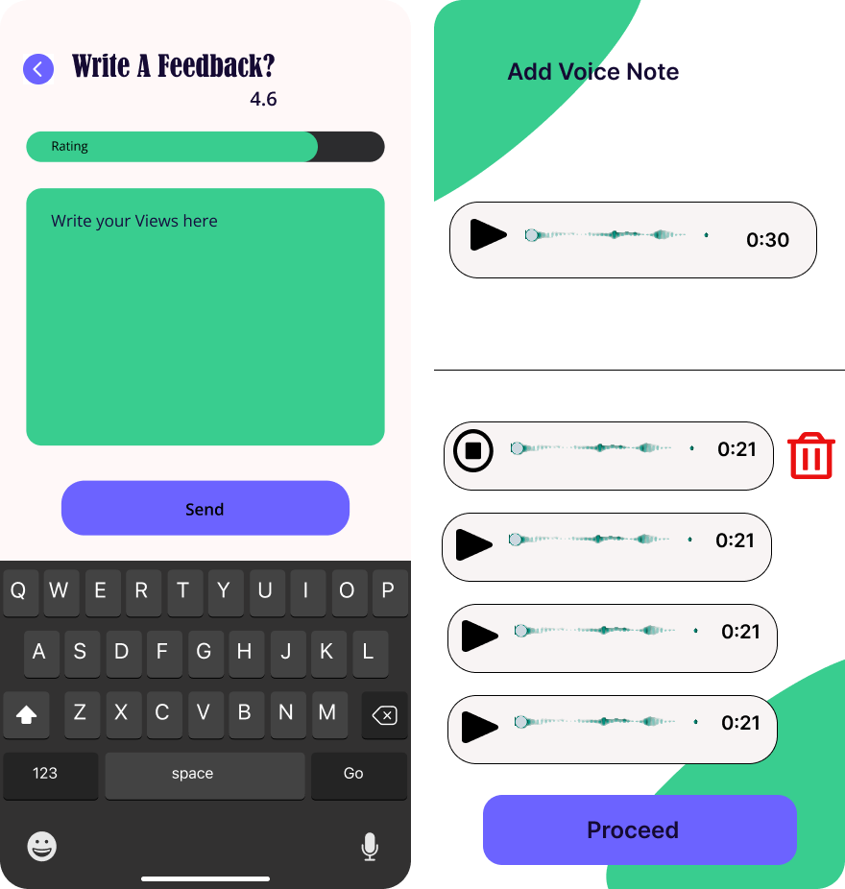
Mockups
Mobile Application Mockups are:
Figure 4: Home Screen Mockup

Slide 36
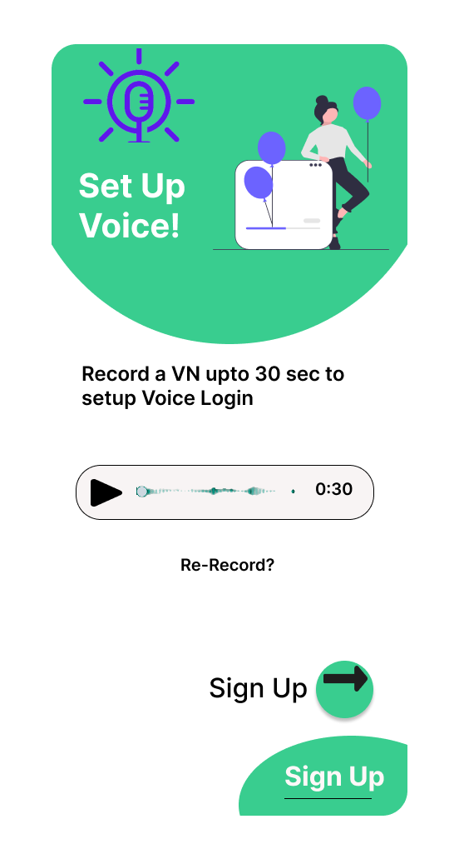
Mockups
Mobile Application Mockups are:
Figure 5: Add Voice Mockup

Slide 37
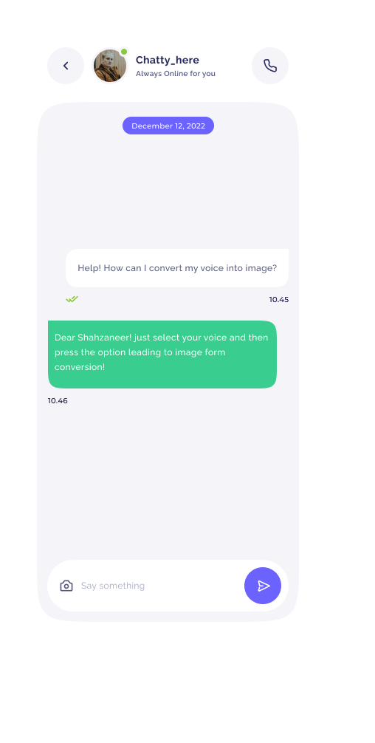
Mockups
Mobile Application Mockups are:
Figure 6: ChatBox Mockup

Slide 38
Conclusion
The Peech2face ultimate objective is to help users to authenticate their logins and signups.
It helps to retrieve images based on voices firstly in vector form and by converting into image.
It also helps agencies to identify the culprits on basis of their voice.
This project will serve as a solid foundation of getting acuities via speech and It will give an amazing experience of authentication for users.

Slide 39
References
Related Systems:
https://www.github.com/topics/sound-classification.
https://speech2face.github.io/
Google Facenet
Youtube Resources:
https://www.youtube.com/watch?v=aKYlSIs3UDY&t=334s

Slide 40
Plaragism Report

Slide 41

Questions and Answers

